Slide 1
CIS 315 Systems Analysis and Design Chapter 8: From Software Analysis to Design
Stefan Bund, MS
Cal Poly Pomona CBA / CIS

Slide 2
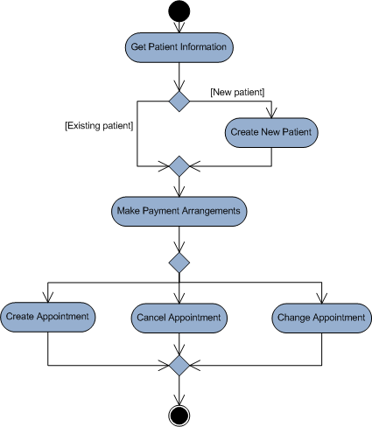
Activity diagram

Slide 3
Structural modeling
CRC cards
Class diagrams

Slide 4
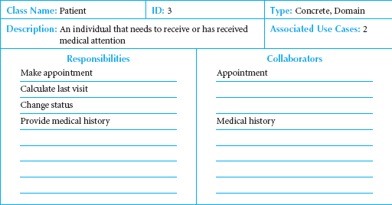
Front-Side of a CRC Card
Doing/Responsibility
Collaboration
CRC cards are used to document the essential properties of a class. Analysts can use them to find missing properties or clarification later.

Slide 5
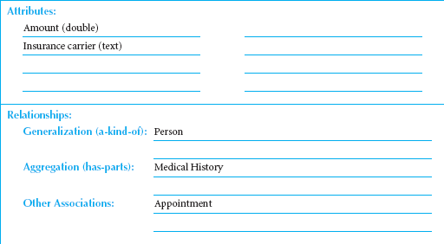
Back-Side of a CRC Card

Slide 6
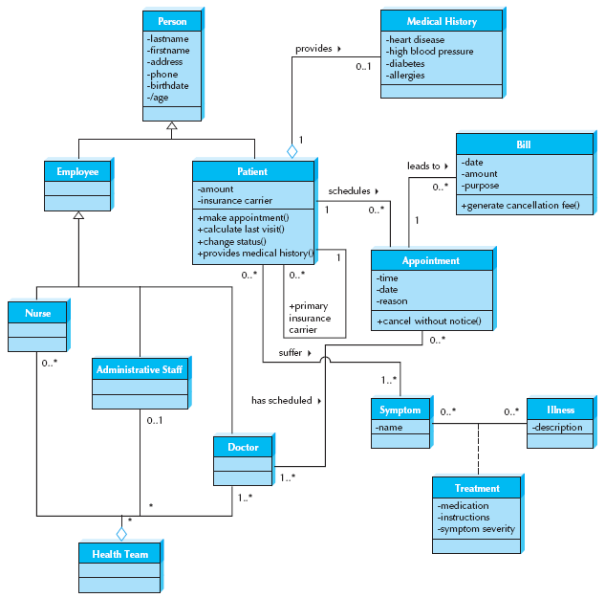
* Attributes and operations are omitted in some classes for simplicity.

Slide 7
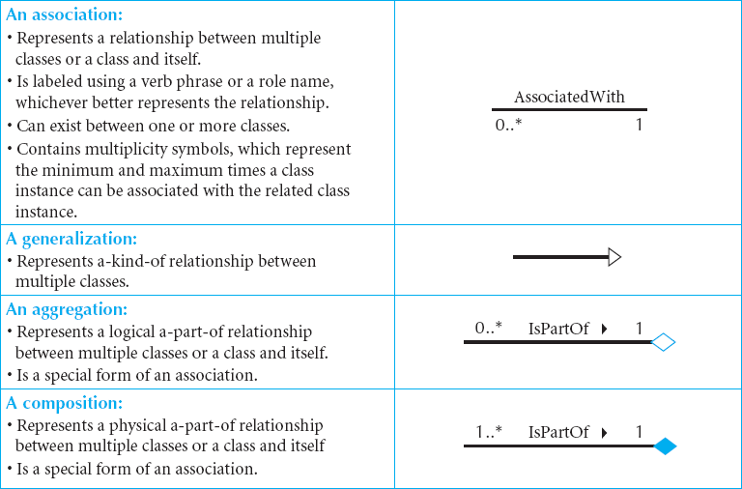
More Elements of Class Diagrams
E.g., The two classes patient and appointment are associated with one another whenever a patient schedules an appointment in Figure 6-2
Notes:
The relationship in diagram is shown as a line connecting two classes.
E.g., The two classes patient and appointment are associated with one another whenever a patient schedules an appointment in Figure 6-2. The triangle/arrow allows a direction to be associated with the name of the relationship. The relationship is to be read as patient schedules appointment. Adding a small arrow besides the name of the relationship increases readability. Sometimes a class is related to itself, as in the case of a patient being the primary insurance carrier for other patients (e.g., spouse, children) in Figure 6-2. A plus () sign is placed before the label to communicate that it is a role as opposed to the name of the relationship.

Slide 8
Multiplicity / Cardinality
Multiplicity/cardinality shows how an instance of an object is associated with instance(s) of another object.
Department
Boss
Exactly one:
A department has one and only one boss
1
1
Employee
Child
Zero or more:
An employee has zero to many children
1
0..*
Boss
Employee
One or more:
A boss is responsible for one or more employees
1
1..*
Notes:
in Figure 6-2, there is a 0..* on the appointment end of the patient schedules appointment relationship. This means that a patient can be associated with zero through many different appointments. (New patient may not have an appointment set yet, postponed or cancelled their first appointment.) At the patient end of this same relationship there is a 1, meaning that an appointment must be associated with one and only one (1) patient

Slide 9
Multiplicity / Cardinality
Employee
Spouse
Zero or one:
An employee can be married to 0 or 1 spouse
1
0..1
Employee
Vacation
Specified range:
An employee can take 2 to 4 vacations each year
1
2..4
Employee
Committee
Multiple disjoint ranges:
An employee can be in 1 to 3 or 5 committees
1
1..3, 5

Slide 10
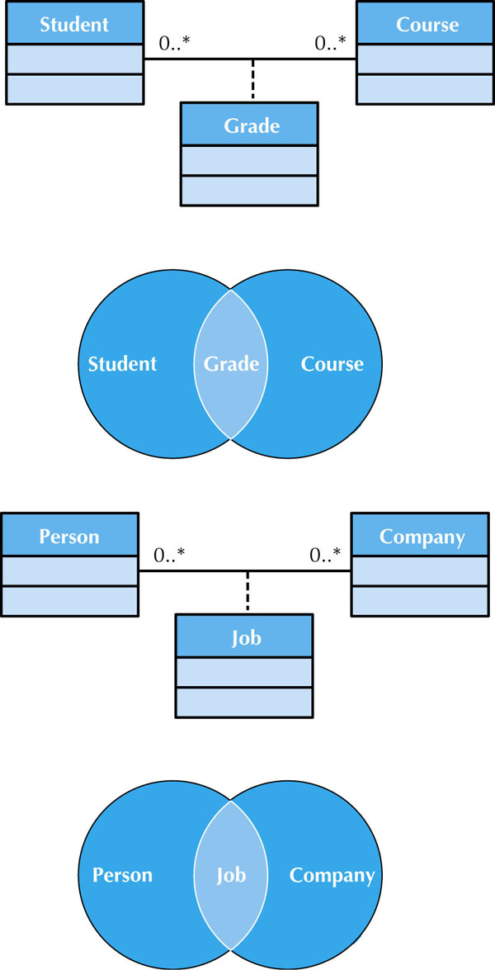
When two or more classes share a many-to-many relationship, a class called an association class is formed, which has its own attributes and operations.
It is shown as a rectangle attached by a dashed line to the association path, and the rectangle’s name matches the label of the association.
← Sample Association Classes

Slide 11
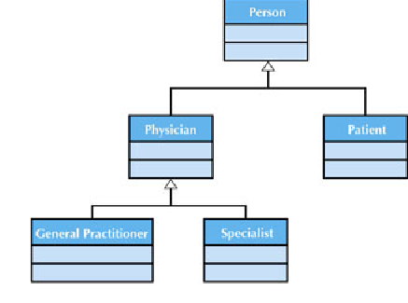
Sample Generalization Association
A Generalization Association (GA) shows that one class (subclass) inherits from another class (superclass), meaning that the properties and operations of the superclass are also valid for objects of the subclass.
GA is represented by a solid line from the subclass to the superclass and a hollow arrow pointing at the superclass. Use words like is a kind of.

Slide 12
Sample Class Diagram
Do you see any association class in this class diagram?
Notes:
e.g., An illness (e.g., the ﬂu) can be associated with many symptoms (e.g., sore throat, fever), and a symptom (e.g., sore throat) can be associated with many illnesses (e.g., the ﬂu, strep throat, the common cold). Figure 6-2 shows how an association class can capture information about remedies that change depending on the various combinations. For example, a sore throat caused by strep throat will require antibiotics; whereas, treatment for a sore throat from the ﬂu or a cold could be throat lozenges or hot tea.

Slide 13
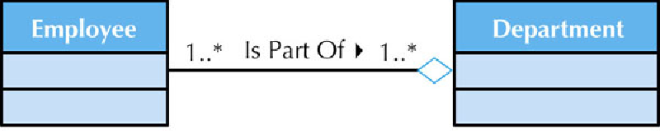
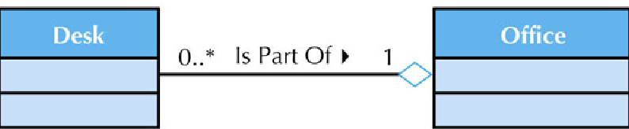
Sample Aggregation Associations
Aggregation represents logical parts to whole relationship
A white diamond is placed nearest the class representing the aggregation (health-care team),
Use words like is a part of or is made up of.

Slide 14
Sequence and communication diagrams

Slide 15
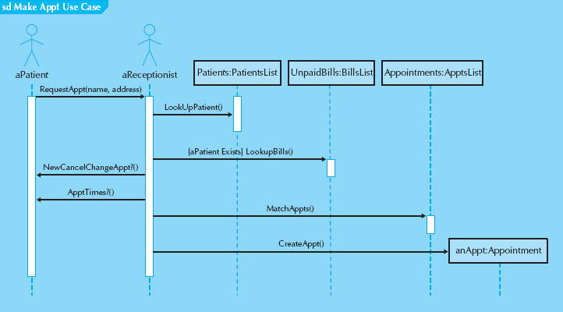
Sample Sequence Diagram
Actors and objects that participate in the sequence are placed across the top of the diagram.
Patients:PatientsList – Patients is an instance of the PatientsList class that contains individual patient objects.
At times a message is sent only if a condition is met. In those cases, the condition is placed between a set of brackets, [ ] {e.g., [aPatient Exists] LookupBills()}. The condition is placed in front of the message name. Don’t use in model for a specific scenario.
There are times that a message is repeated. This is designated with an asterisk (*) in front of the message name (e.g., * Request CD).
Sometimes, an object will create another object. This is shown by the message being sent directly to an object instead of its lifeline. In Figure 7-1, the actor aReceptionist creates an object anAppt.

Slide 16
Steps to Build Sequence Diagrams
Set the context
The context of the diagram can be a system, a use case, or a scenario of a use case. The context of the diagram is depicted as a labeled frame around the diagram
Identify which objects will participate
That is, the objects that interact with each other during the use-case scenario.
Set the lifeline for each object
draw a vertical dotted line below each class to represent the class’s existence during the sequence. Is the object no long need at the end? (x)
Lay out the messages from top to bottom of the diagram based on the order in which they are sent
draw arrows in order to represent the messages being passed from object to object in time, with the arrow pointing in the message’s transmission direction. Add parameters into parentheses after message name.
Add execution occurrence to each object‘s lifeline
draw a narrow rectangle box on top of lifeline to show sending/receiving message.
Validate the sequence diagram

Slide 17
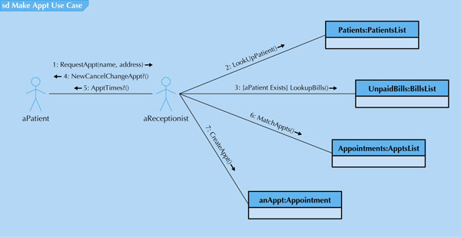
Sample Communication Diagram
When fully populated communication diagrams can be complex and difficult to understand. To simplify them, its objects can be logically grouped (package) together based on the messages sent to and received from the other objects.

Slide 18
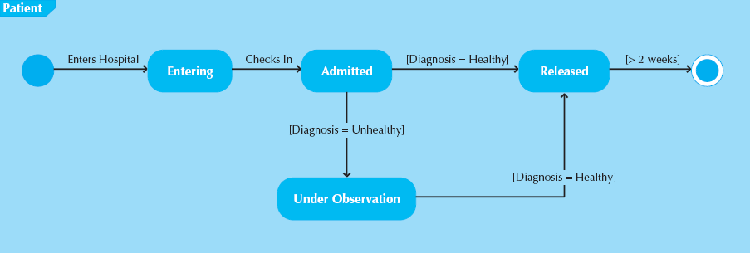
Sample State Machine
An example of a behavioral state machine representing the patient class in the context of a hospital environment.

Slide 19
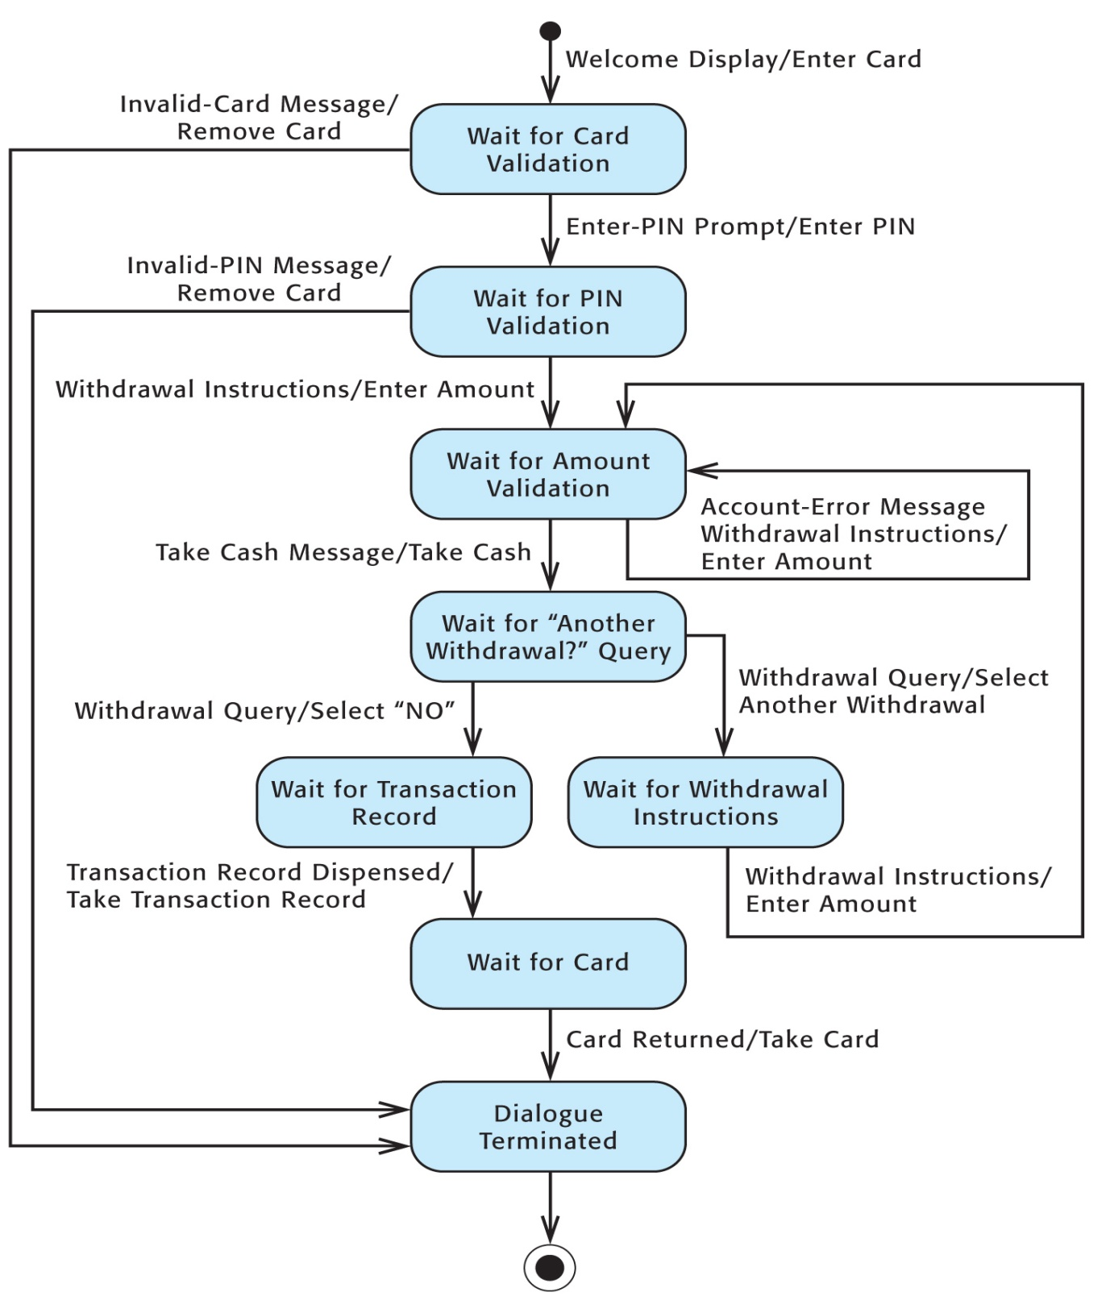

Slide 20
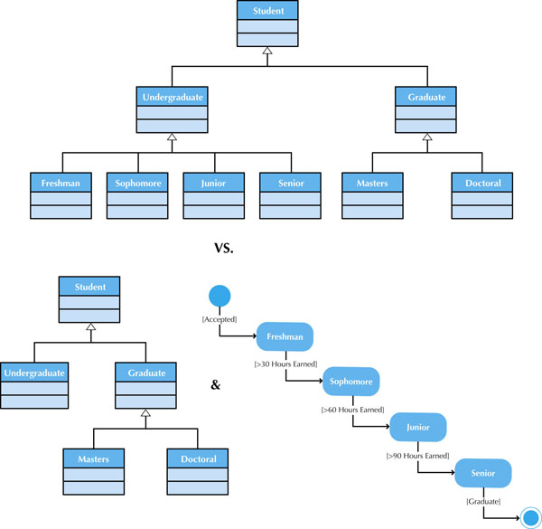
Figure 7-12 States vs. Subclasses

Slide 21
Moving on to design
Chapter 8 material

Slide 22
Functional Model V&V
Events in Use Case descriptions should map to activities in the Activity Diagram
Object node in an activity diagram must be mentioned in Use Case descriptions
Sequential ordering within the Use Cases should match ordering in Activity Diagram
There must be a one-to-one correspondence of Use Cases in the Use Case Diagram and Use Case descriptions.
All actors listed in a use case description must be portrayed on the use-case diagram
Include stakeholders listed in the use case description as actors in the use-case diagram
All relationships listed in a use-case description must be portrayed on a use-case diagram

Slide 23
Structural Model V&V
Every CRC card should be associated with a class on the class diagram
Responsibilities listed on the CRC card must be operations in a class on a class diagram
Collaborators on the CRC card imply some type of association on the class diagram
Attributes listed on CRC cards must be attributes in a class on a class diagram
Class attributes with a type that is another class imply a relationship between classes
Relationships on the CRC cards must show up on the class diagram
Use association classes only if the association has unique attributes not on either class

Slide 24
Behavioral Model V&V
Actors & objects on sequence diagrams must be included on communication diagrams
Messages on sequence diagrams require associations on communications diagrams
Every message on a sequence diagram must appear as a message on an association in the corresponding communication diagram
Guard conditions messages in sequence diagrams require equivalent guard conditions on the corresponding communication diagrams
The sequence number on message labels in communications diagrams must correspond to the top-down ordering of the messages being sent on the sequence diagram
State machine transitions must be associated with a messages on sequence & communication diagrams
All entries in a CRUD matrix imply a message being sent between an actor or object and another

Slide 25
Evolving the Analysis Models into Design Models

Slide 26
Factoring
Creating modules that account for similarities and differences between units of interest.
Creating new classes by
Generalization (is-a relationship)
Aggregation (has-parts relationship)
Two processes related to factoring
Abstracting
From classes of Nurse, Admin Staff, and Doctor to factor out a new class, Employee.
Refinement
From Admin Staff class to refine subclasses, Receptionist and Secretary.

Slide 27
Partitions and Collaborations
Decompose a larger system by creating “subsystems” or larger units
Accounting system could be functionally decomposed into an accounting payable system, an account receivable system, and a payroll system.
The more messages between objects, the more likely they are in the same partition
Grouping units that collaborate
May have collaboration among units or partitions
The more messages or contracts between objects, the more likely they are in the same partition

Slide 28
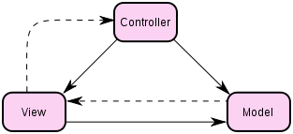
Layers
Consider system environment information to help evolve the analysis model
Model-view-controller (MVC) architecture
Separating application logic from user interface logic
Model provides the application logic & data
View handles the output
Controller handles input passed from View

Slide 29
5 Layers
Foundation
It contains software classes
Problem Domain
This is what we have focused on through most our chapters so far
Data Management (Chapter 10)
Persistence of data, such as storing data in relational databases
Human-Computer Interaction (Chapter 11)
It contains classes related to View and Controller and those classes are separated from the problem domain classes
Physical Architecture
How software will execute on specific hardware and networks

Slide 30
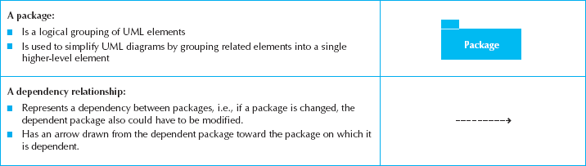
Package
A general construct that groups units together
Used to reduce complexity of models
A package diagram shows packages only

Slide 31
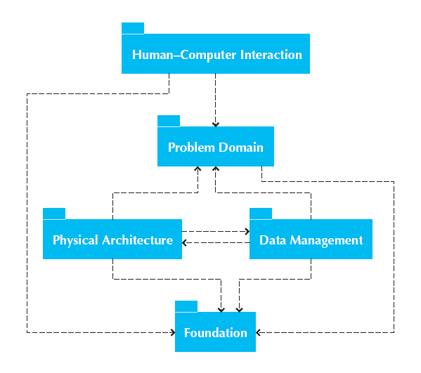
Package Diagram for 5 Layers

Slide 32
Building Package Diagrams
Set the context
Cluster classes together based on shared relationships
Model clustered classes as a package
Identify dependency relationships among packages
Place dependency relationships between packages

